Slide 1
THEE project
Iona Nufer & Pascal Graber

Slide 2
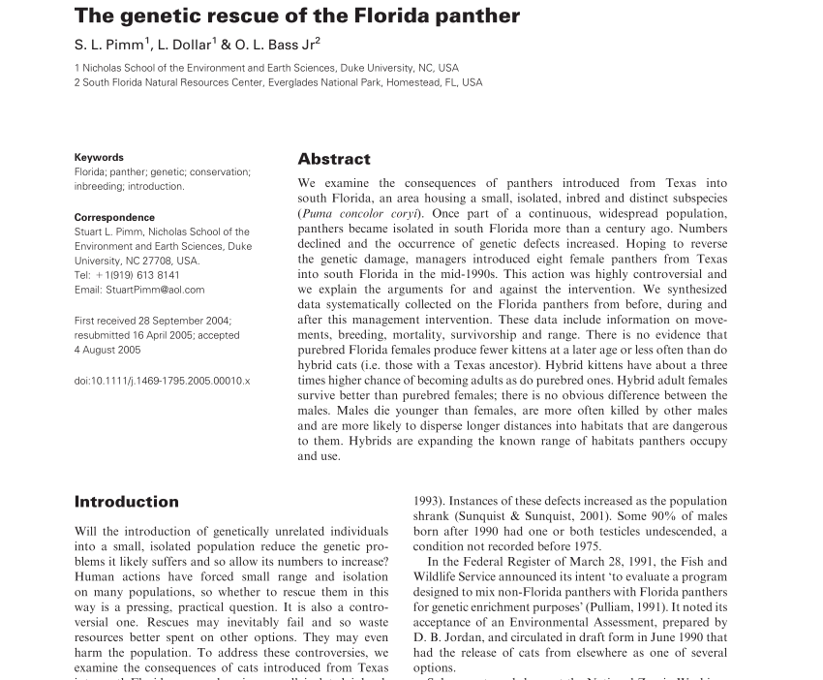
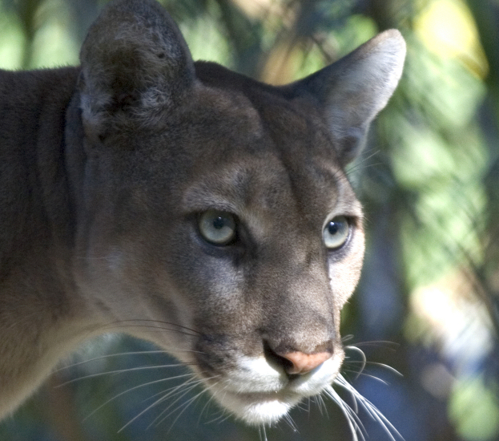
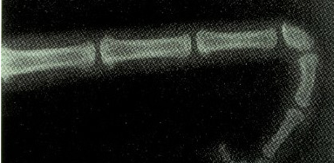
Evolutionary rescue
Florida panther
Aguilar-Gómez, Diana et al. “Genetic rescue of Florida panthers reduced homozygosity but did not swamp ancestral genotypes.” Proceedings of the National Academy of Sciences of the United States of America vol. 122,31 (2025): e2410945122. doi:10.1073/pnas.2410945122

Slide 3
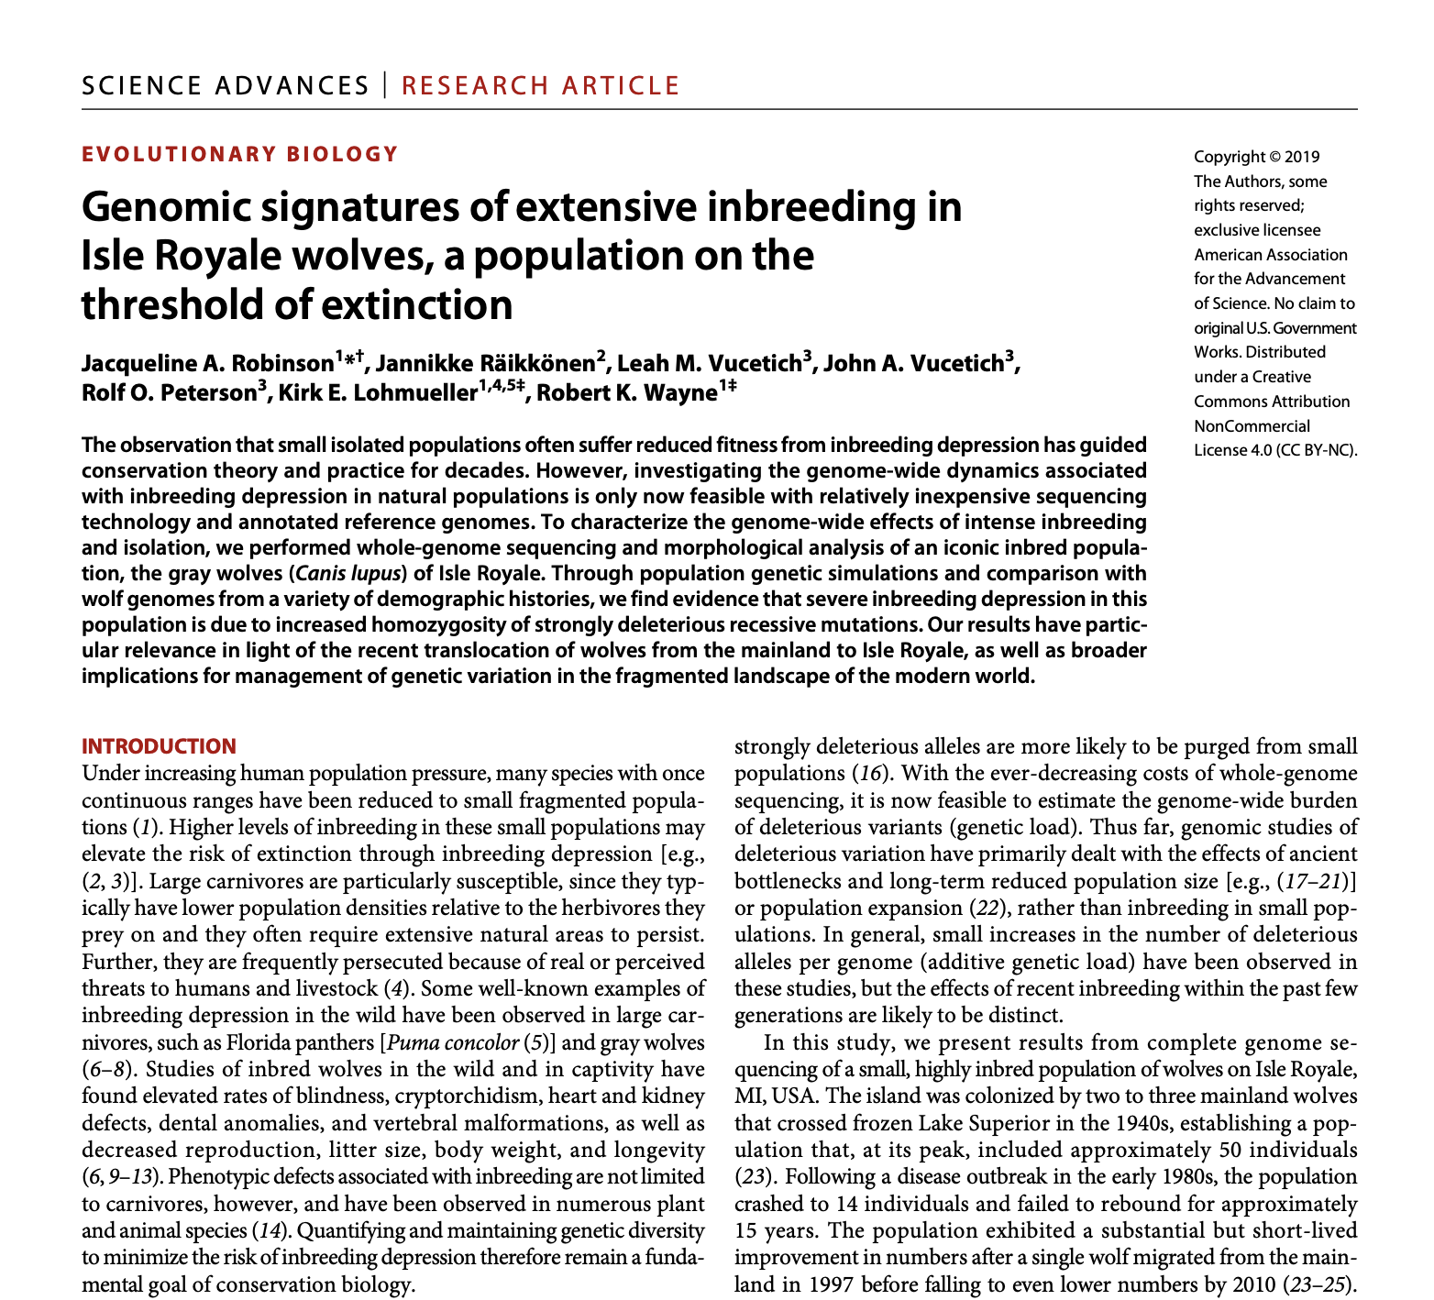
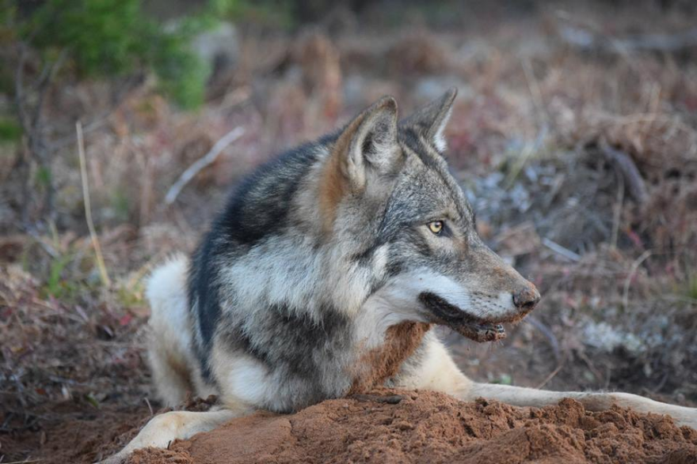
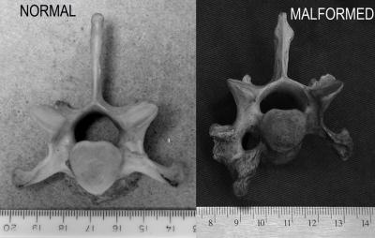
Evolutionary rescue
Isle royal wolves
Robinson, Jacqueline A et al. “Genomic signatures of extensive inbreeding in Isle Royale wolves, a population on the threshold of extinction.” Science advances vol. 5,5 eaau0757. 29 May. 2019, doi:10.1126/sciadv.aau0757
Notes:
Inbreeding depression due to increased homzygosity of deleterious recessive mutations

Slide 4
Question
How many individuals must be introduced at time x to rescue an allele of a homozygote population with low fitness?

Slide 5
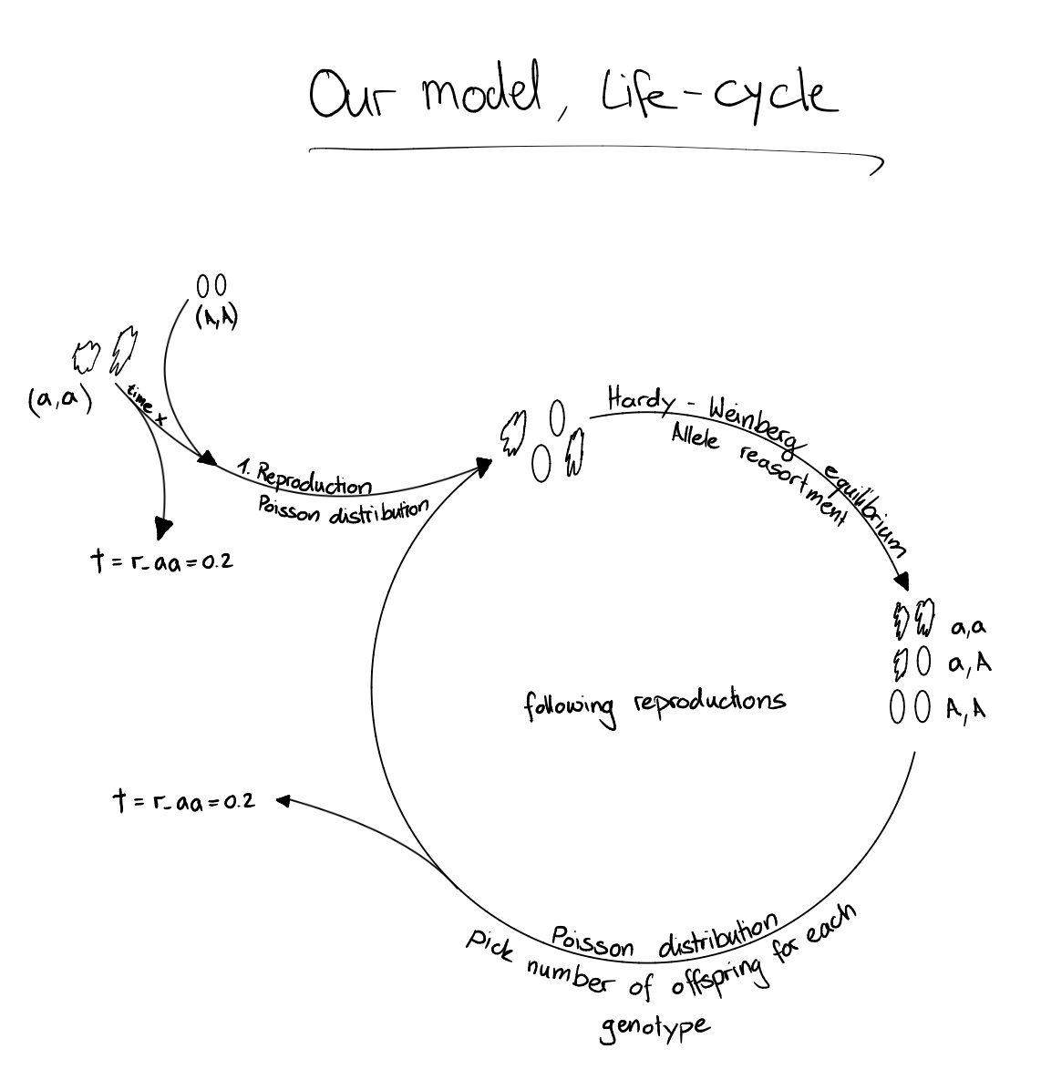

Slide 6
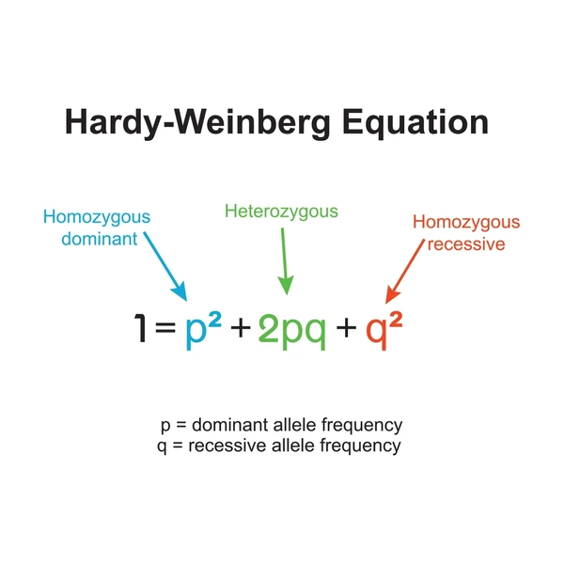
Methods
Parameter:
N_aa
N_AA
R_aa
S_aA
S_AA
Functions:
Simulate_gen
Simulate_pop

Slide 7
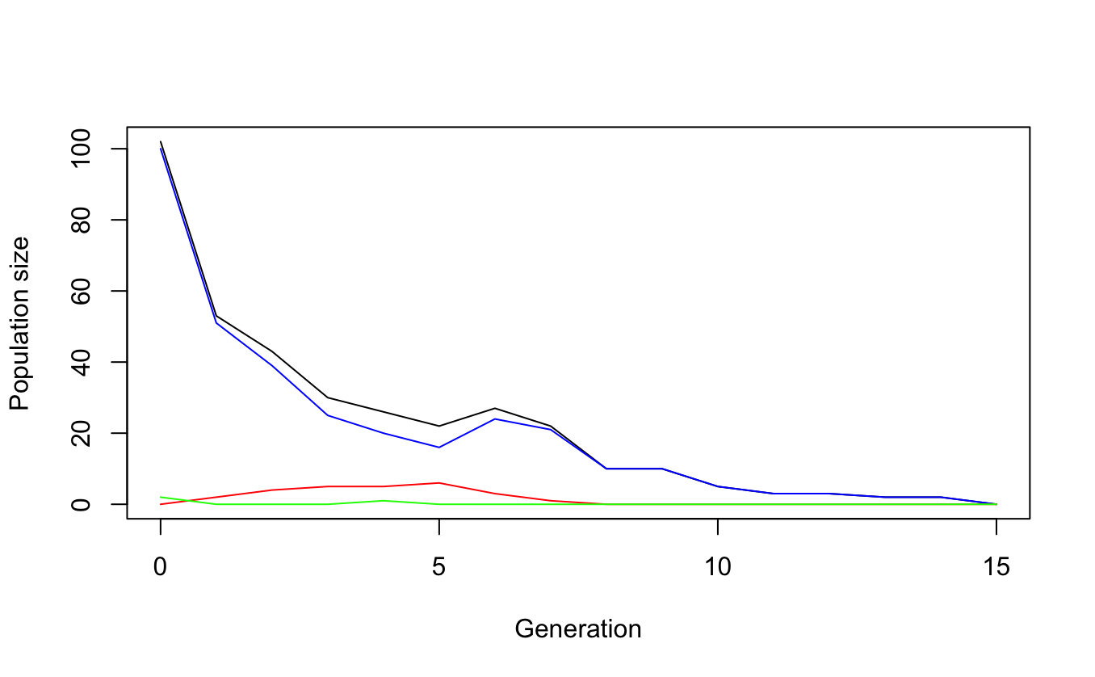
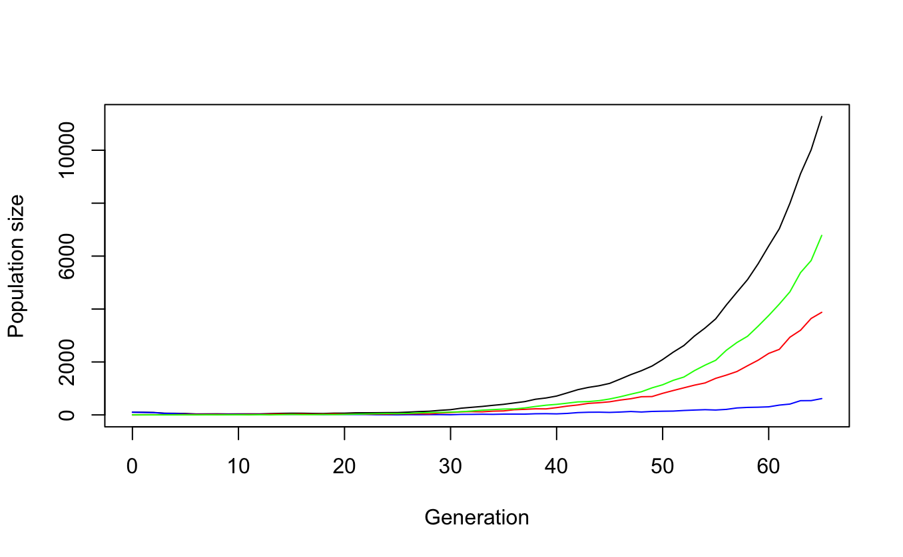
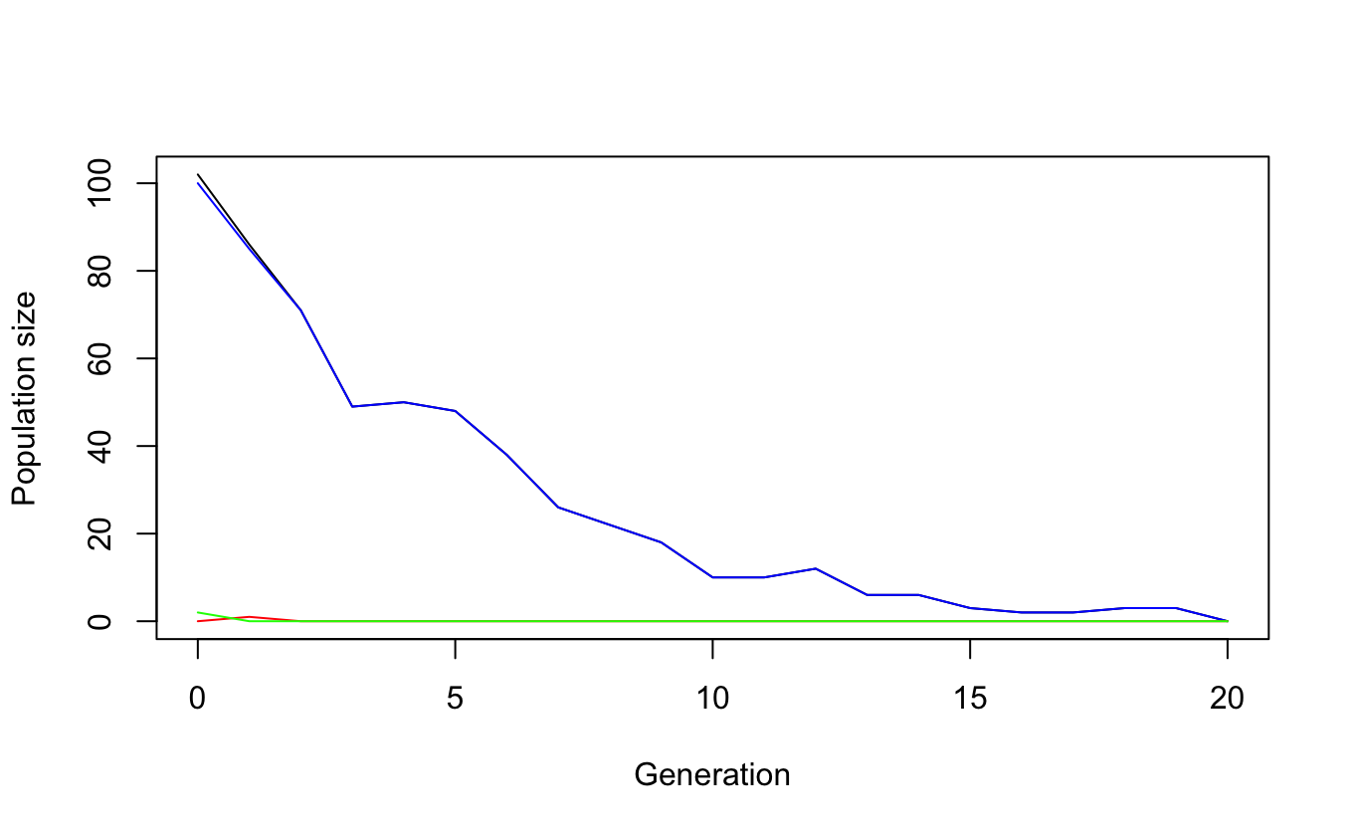
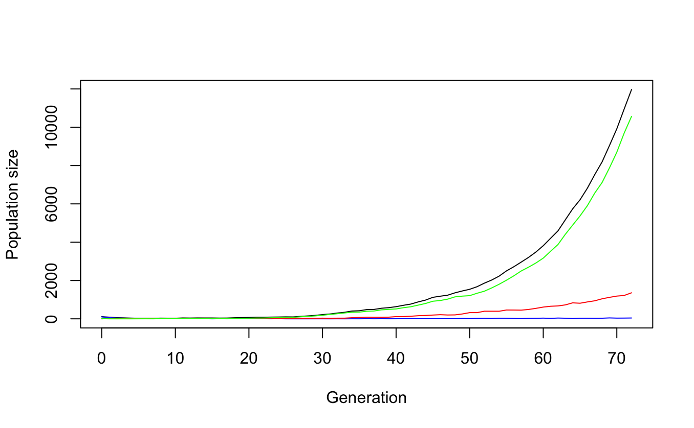
Simulation of one population
N_aa <- 100
N_AA <- 10
r_aa <- 0.2
s_aA <- 1.10
s_AA <- 1.10
t_max <- 1000
Legend:
Blue -> aa
Red -> aA
Green -> AA
Black -> total pop size
Notes:
Stop after pop size reaches 100x original pop size

Slide 8
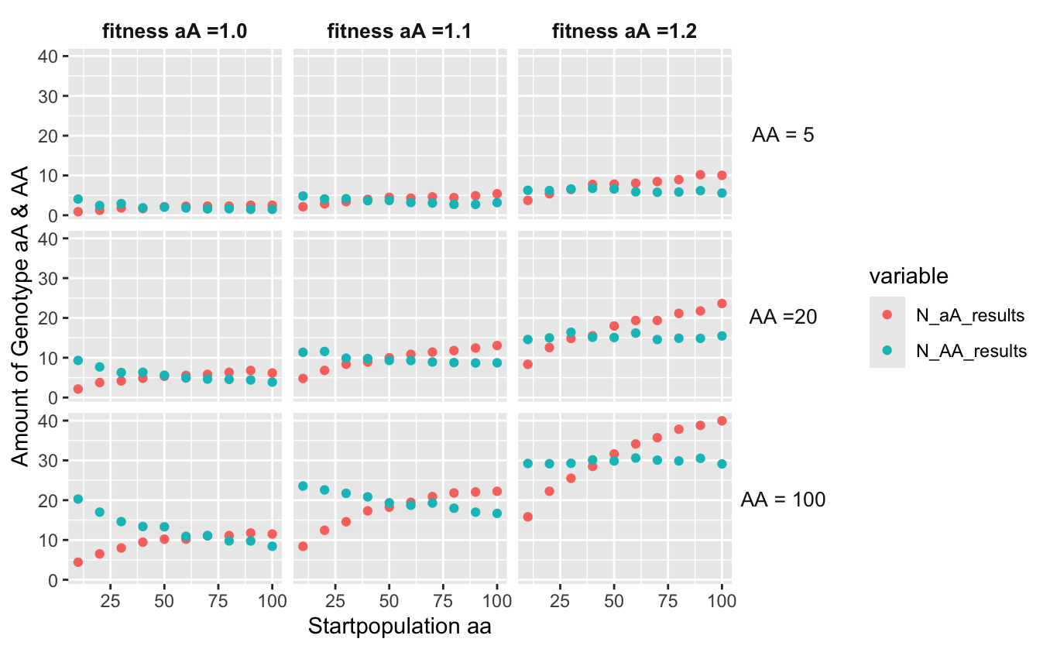
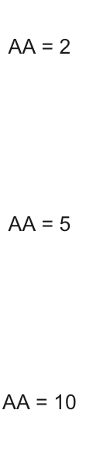
Multiple populations with changing parameters
N_aa_vector <- c( seq(10, 100, by=10))
N_AA_vector <- c(10, 5, 2)
s_aA_vector <- c(1, 1.1, 1.2)
No_replicats <- 1000
Number of aA & AA at the end of simulation
Legend:
Start population aa

Slide 9
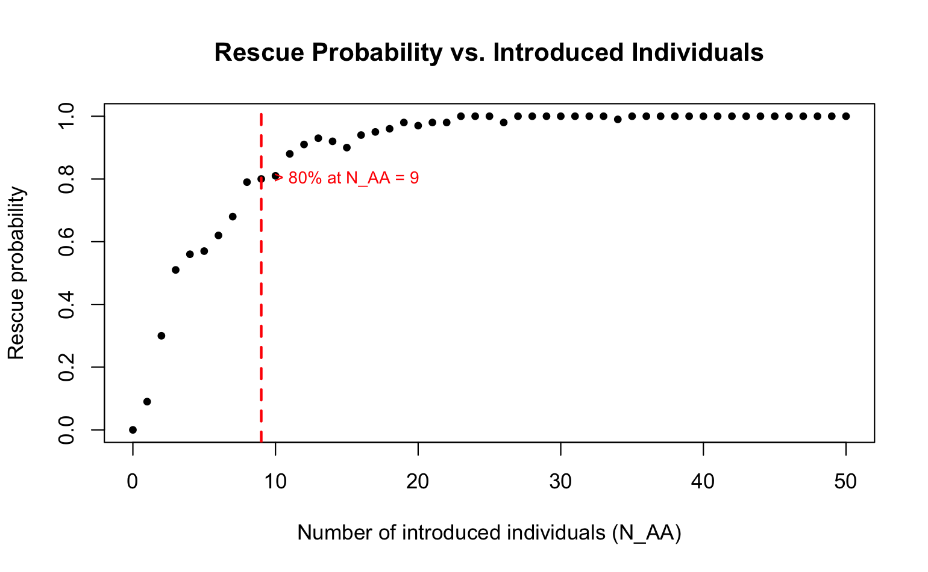
Rescue probability
Condition for rescue = reach again initial population size
N_aa <- 100
N_AA <- 0 - 50
r_aa <- 0.2
s_aA <- 1.10
s_AA <- 1.10
n_reps <- 100
Does this answer our question?

Slide 10
Question
How many individuals must be introduced at time x to rescue an allele of a homozygote population with low fitness?

Slide 11
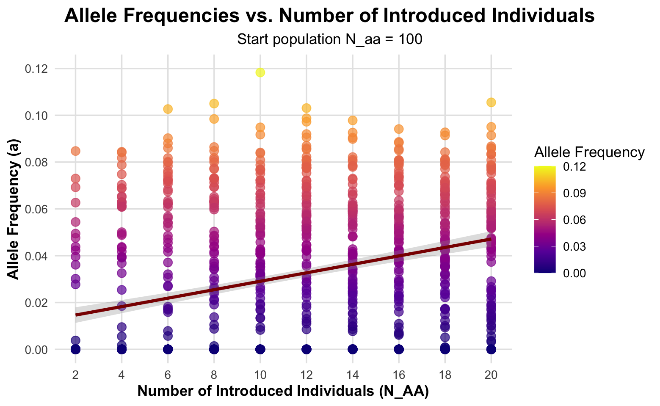
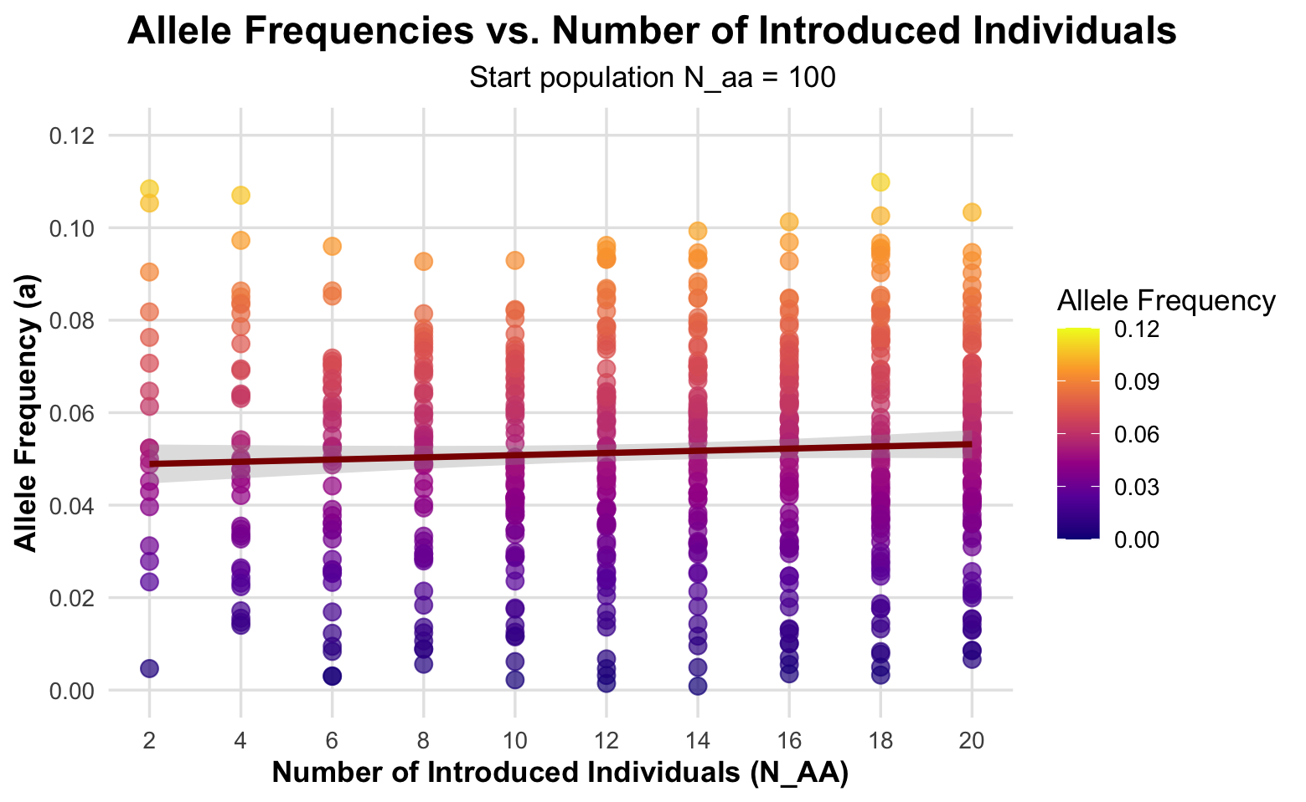
Allele frequency (a) vs. Introduction
N_aa <- 100
N_AA <- 2 - 20
r_aa <- 0.2
s_aA <- 1.10
s_AA <- 1.10
n_reps <- 100
Number of introduced Individuals seems to have no big impact after a certain threshold

Slide 12
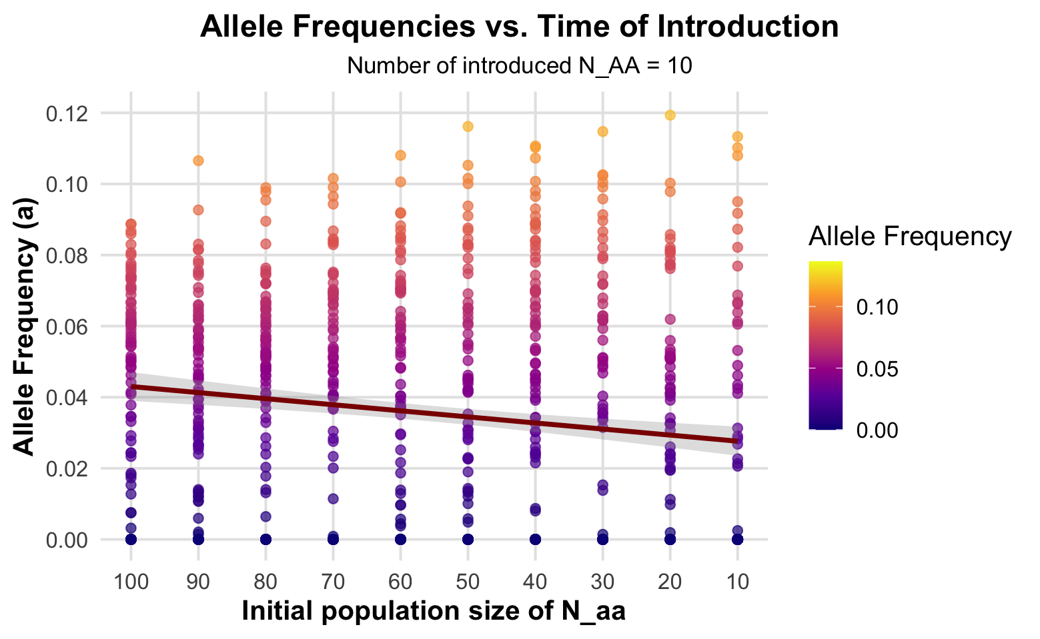
Allele frequency (a) vs. Time of Introduction
N_aa <- 100 - 10
N_AA <- 10
r_aa <- 0.2
s_aA <- 1.10
s_AA <- 1.10
n_reps <- 100
Initial pop. size of aa is a proxy for time!
Time of introduction seems to be important (especially at low numbers of introduced Individuals)

Slide 13
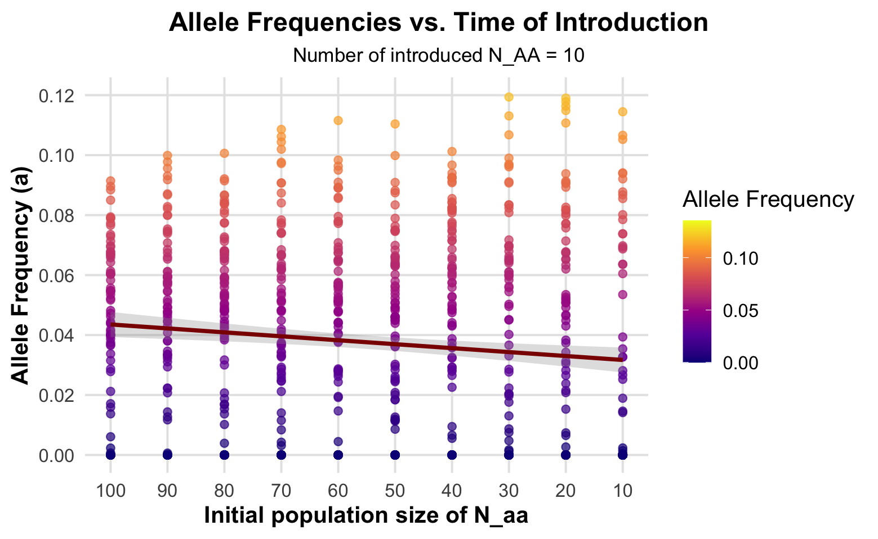
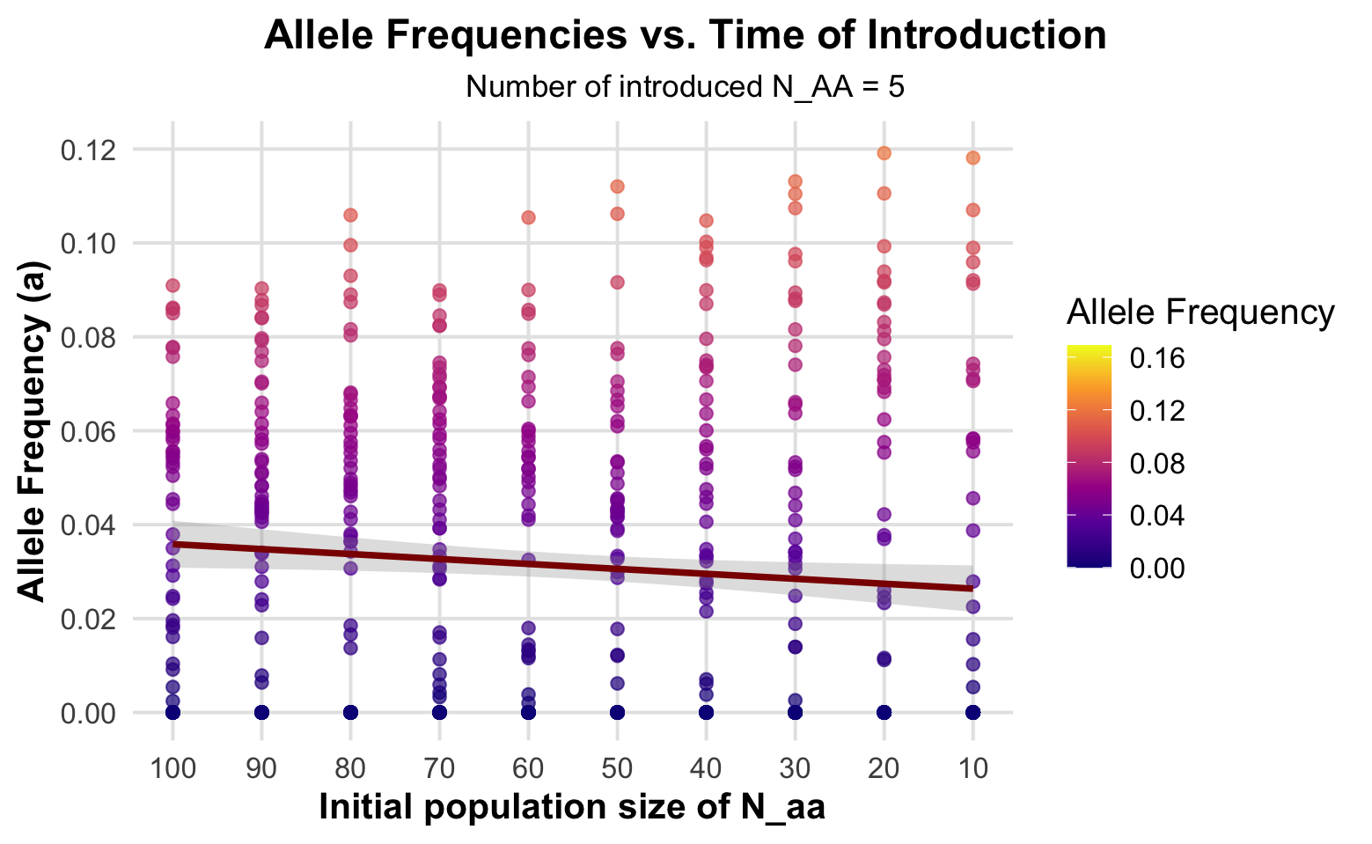
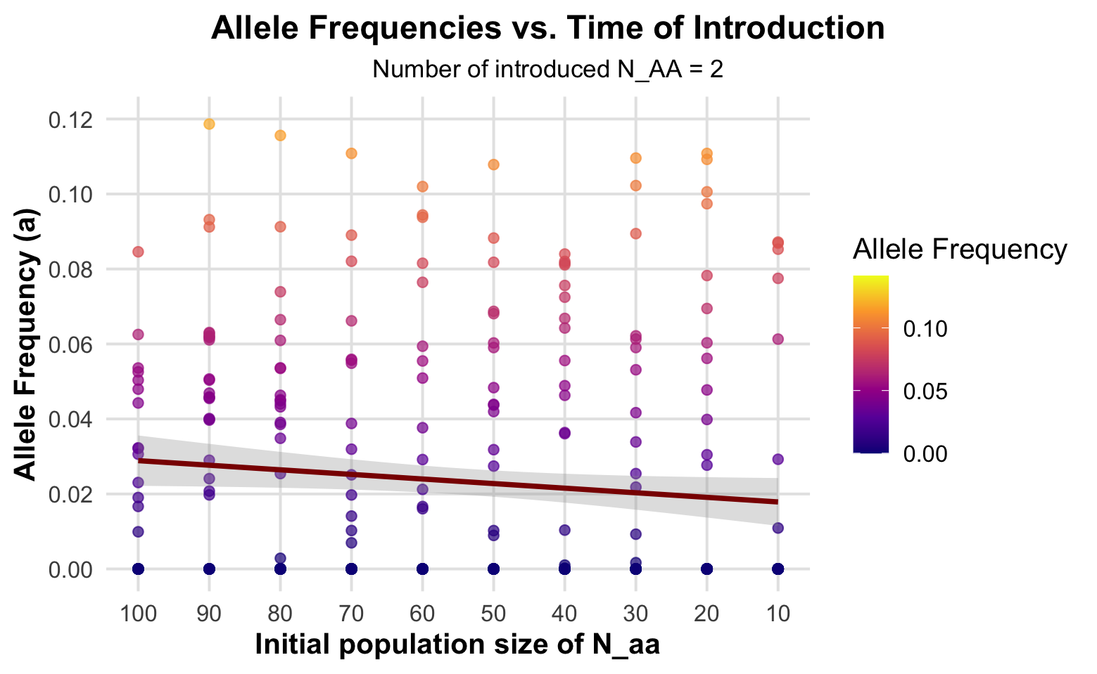
Both Time & Number matters

Slide 14
Limitations of our model
No life stages -> every individual can reproduce
No overlapping generations
Very simplyfied model -> no enviromental factors, no density-dependence etc.

Slide 15
Conclusions
Question:
How many individuals must be introduced at time x to rescue an allele of a homozygote population with low fitness?
How many:
After a certain threshold, increasing the number of individuals of Introduction, don't increase the rescue probability any further (in our model 8-10 individuals)
Relevance for project planning -> don't waste resources
Time:
At which time we introduce seems to play an important role
Early introductions can rescue the population even with a small number of introductions
Relevance for project planning -> act early on if possible

Slide 16
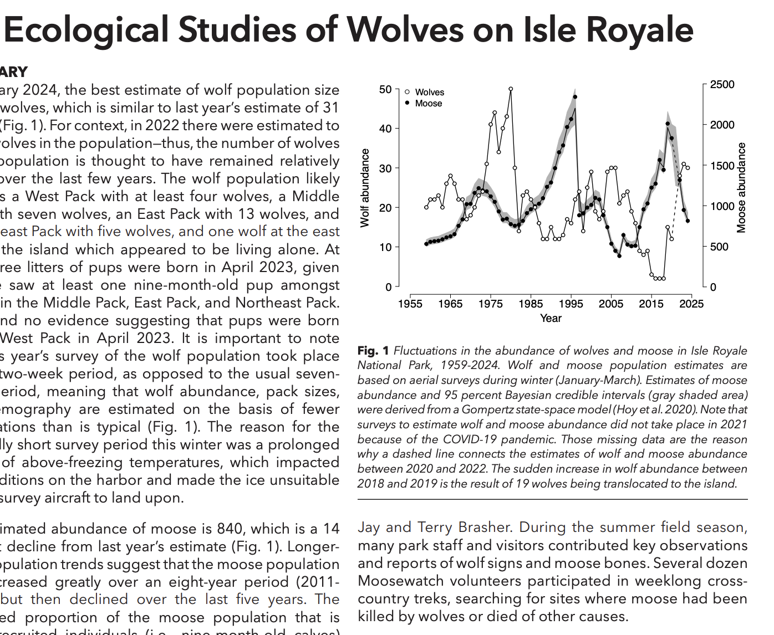
Evolutionary rescue
Isle royal wolves
Hoy, Sarah; Peterson, Rolf O.; and Vucetich, John, "Ecological Studies of Wolves on Isle Royale" (2024). Ecological Studies of Wolves on Isle Royale. 66.
Notes:
Reintroduction 1x naturally, one male was able to save the genetic diversity in the pop
Now: pop was at 4, reintroduced 12 -> now 30 diversity higher, still monitored
Only 3 pups last year, in pop different generations which not all reproduce -> limitation of our model

Slide 17

Additional thoughts
What defines rescue?
other application approaches

Slide 18

there still questions?

Slide 19

Thank you for your attention!

